Slide 1
Back to School 2023-2024
Ms. Gossett’s Class
Fourth Grade

Slide 2
Daily Schedule
Tuesday
7:50 School Begins
7:50-8:00 Daily Math
8:00-8:30 DELD/iReady
8:30-9:00 2nd Step
9:00-10:00 Math
10:00-10:30 Lunch
10:30-11:20 ELA
11:20 Dismissal
M,W, TH, F
7:50 School Begins
7:50-8:00 Daily Math
8:00-8:30 DELD/iReady
8:30-9:50 Math
9:50-10:03 Recess
10:03-11:30 Language Arts
11:30-12:10 Lunch
12:10-12:30 Reading
12:30-1:00 CAAT
1:00-1:30 PE (M, W, TH)
1:30-2:20 Science/Social Studies
2:20-2:30 Clean up/Agendas
2:30 Dismissal

Slide 3
Communication
You can contact me through:
Email: natasha_gossett@chino.k12.ca.us
Parent Square: https://www.chino.k12.ca.us/domain/4800
I will try to return all calls/emails within 24 hours on school days.

Slide 4
The Cortez Four

Slide 5
PBIS: Rewards
Cougar Cash
Terrific Tickets
Rewards are given for exhibiting the Cortez Four. The students and I also develop expectations for the class. These behaviors are also rewarded.

Slide 6
Discipline
Negative behaviors will be documented on a behavior log.
Consistently showing negative behaviors will lead to:
Parent/Teacher Communication
Code of Conduct-Please sign and return.
Parent/Teacher/Admin Communication
Office Discipline Referral

Slide 7
Curriculum
McGraw-Hill (Wonders): Language Arts
Savvas: Math
Harcourt: Social Studies (California History)
Science: Twig
All curriculum is available through Class Link except Social Studies.

Slide 8
Technology
Google Classroom
Please accept invitation.
Parents can’t join the class, but they can view student’s activity with a daily report.
iReady
Excellent resource for both math and language arts reinforcement.

Slide 9
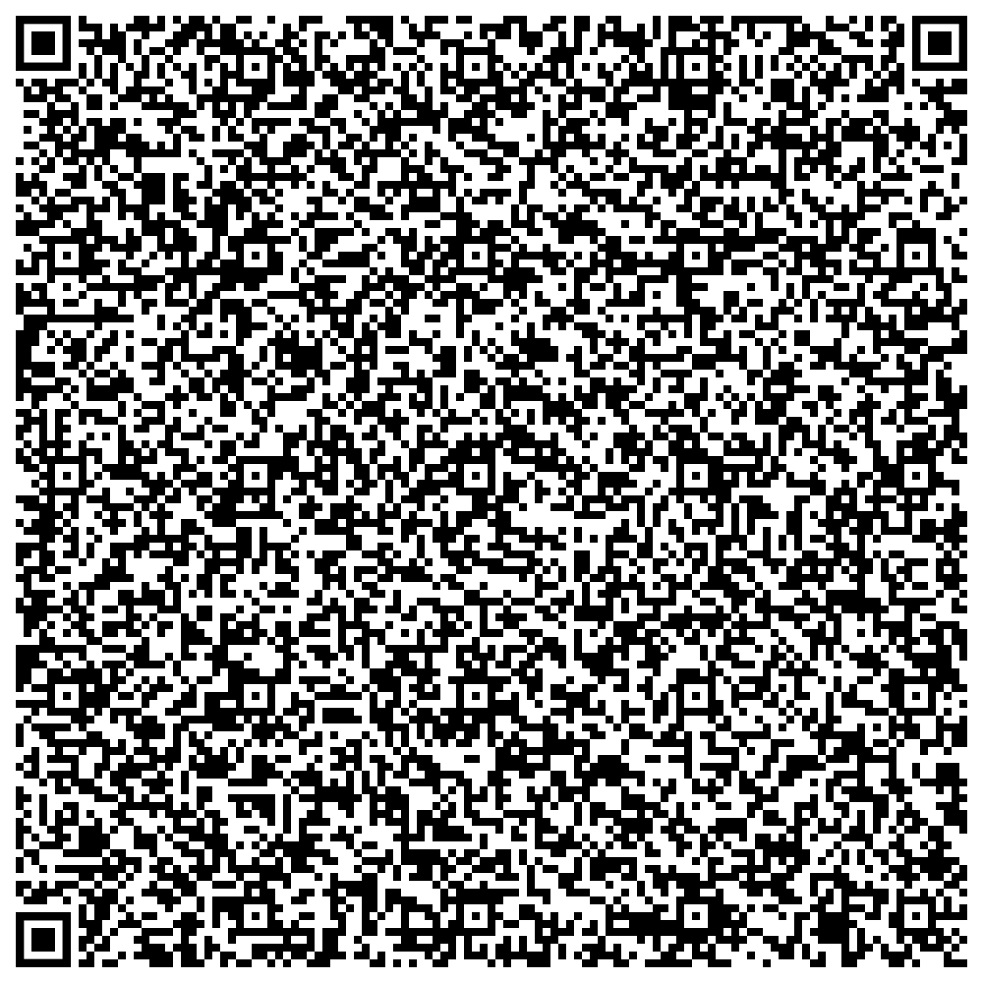
Accelerated Reader
Students must read daily for at least 20 minutes.
I recommend they read one book at a time.
They need to read a book in their ZPD. (EX: 4.0-5.0)
Students generally take at least one quiz per week.
Goals are yearlong.
You may check your child’s progress through AR Home Connect.

Slide 10
Grading Procedure
Standards Based Grades
4: Exceeding Standards (90%-100%)
3: Meeting Standards (75%-89%)
2: Standards Nearly Met (60%-74%)
1: Standards Not Met (0%-59%)
Grades will be posted in Aeries which can be accessed through the Parent Portal.
https://www.chino.k12.ca.us/Page/21603

Slide 11
Agendas are filled out daily with assigned homework.
Please check through homework and sign/initial agenda.
Daily reading is mandatory.
Homework regularly consists of spelling, math, & reading.
Unfinished classwork may occasionally need to go home.

Slide 12
Attendance
Attendance is extremely important for your child’s academic success.
Students are responsible for asking for make-up work and unfinished classwork.
Multiple missing assignments will negatively affect progress.
Please try to avoid taking your child out of class early or arriving late.

Slide 13
Questions?

